Slide 1
CA1 DELE cnn by: adam 2317425

Slide 2
Table of content
Background research and exploratory data analysis
Modelling and evaluation
Model improvement with Data Augmentation
Model improvement with HyperparameterTuning

Slide 3
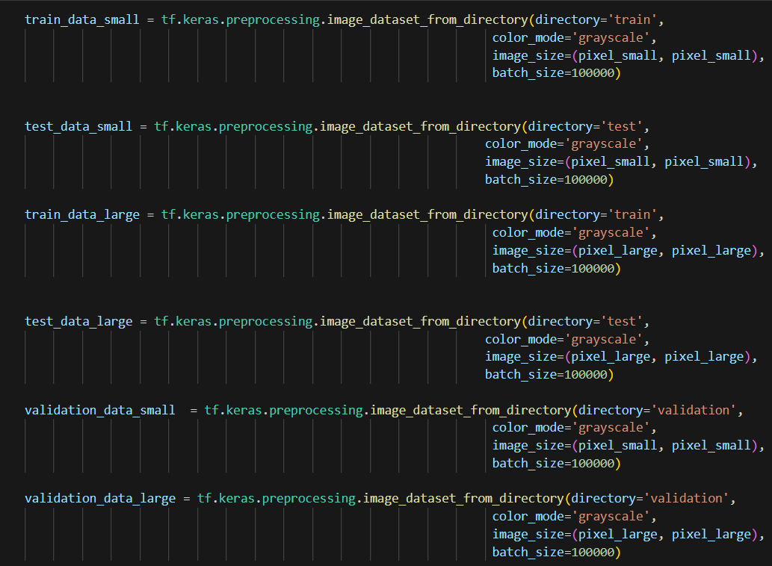
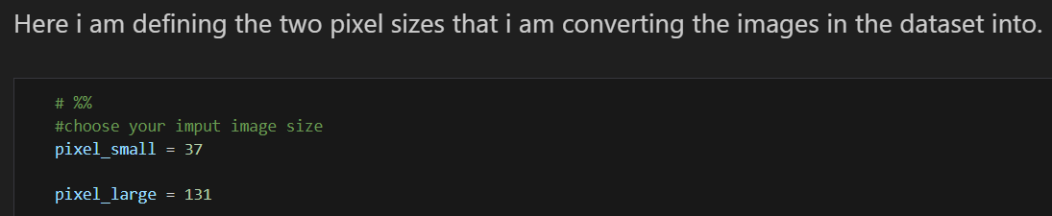
Background research and EDA
The dataset includes 15 common sorts of vegetables that we are familiar with. These includes beans, severe gourd, bottle gourd, brinjal, broccoli, cabbage, capsicum, carrot, cauliflower, cucumber, papaya, potato, pumpkin, radish, and tomato. A dataset of 21,000 pictures was utilized, with each vegetable course containing 1400 pictures measured at 224×224 pixels in .jpg organize. The dataset was partitioned into 70% for training, 15% for testing, and 15% for validation.
The task of CA1 requires me to convert these images into 37 by 37 pixels and 131 by 131 pixels by creating two types of Neural networks for each input size.
I am defining the train, test and validation data in this code

Slide 4
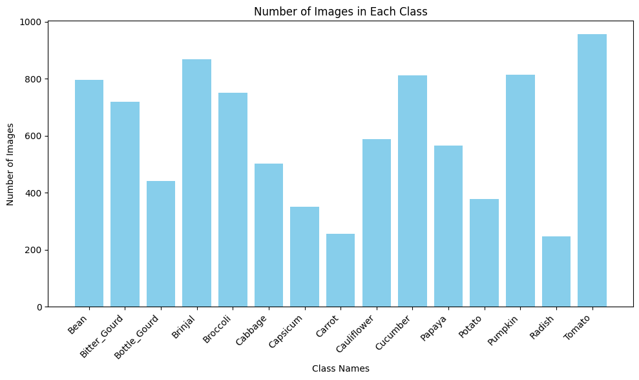
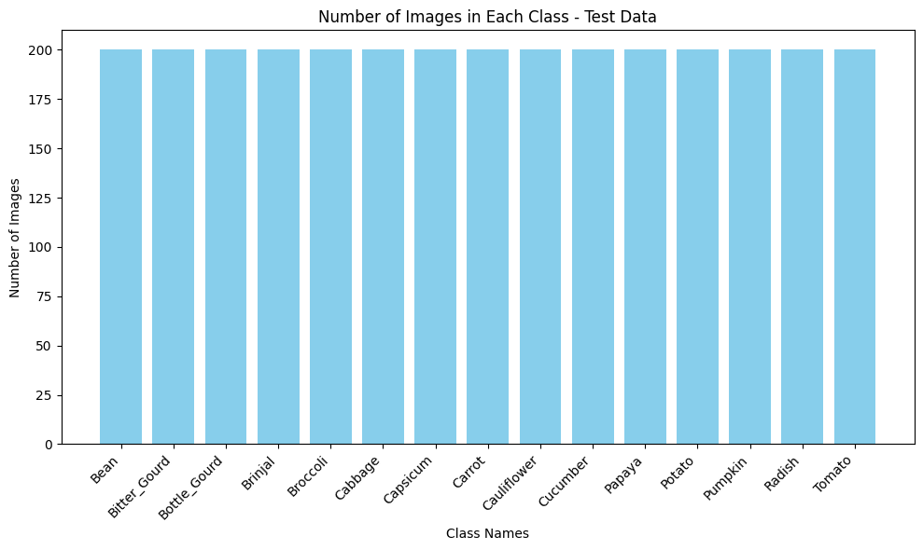
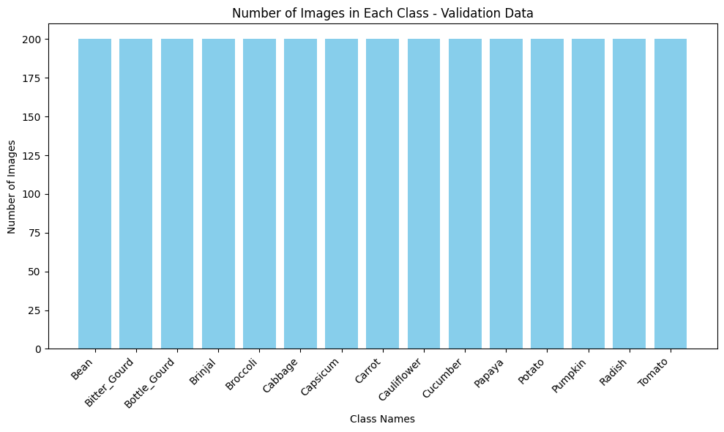
eda
From the bar charts , we can see that from the train_data, the 15 classes of images all have different number of images which would result in oversampling of some classes of vegetables that has more images in it. While in Test and Validation data, all of the classes have a equal number of images. After going through the train dataset , I have found out that there are some images of carrots in beans folder and copies of the same bean images and so I have decided to delete them from the train dataset.

Slide 5
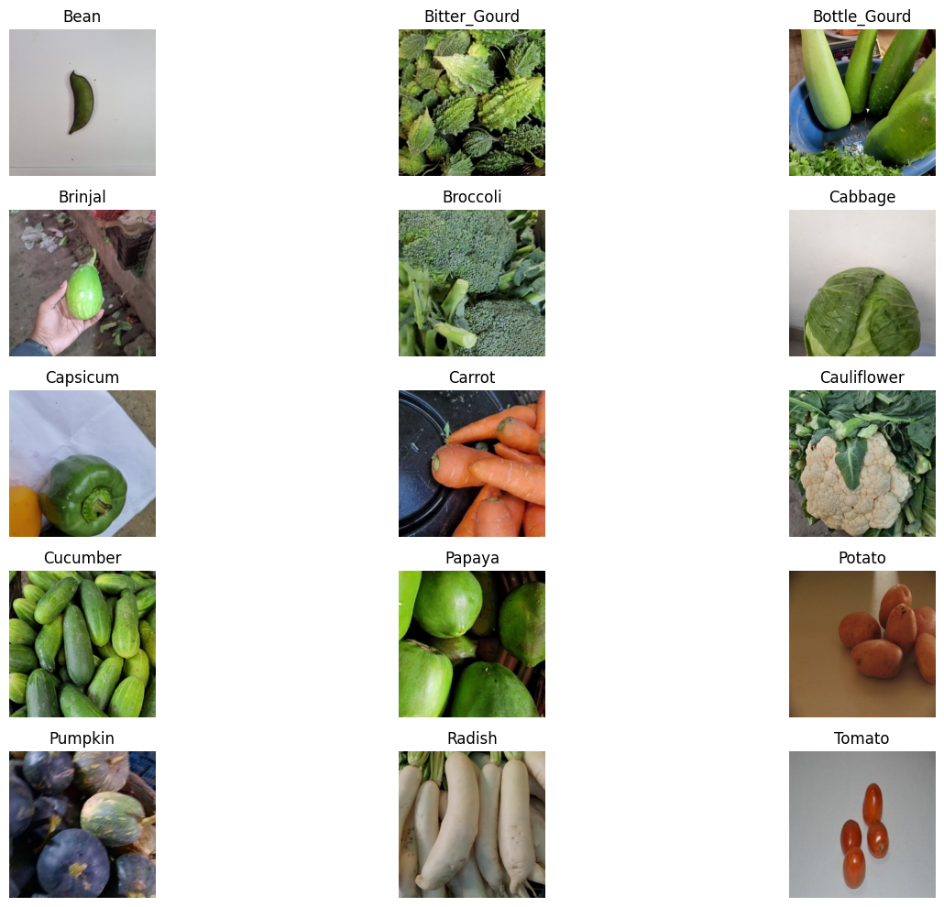
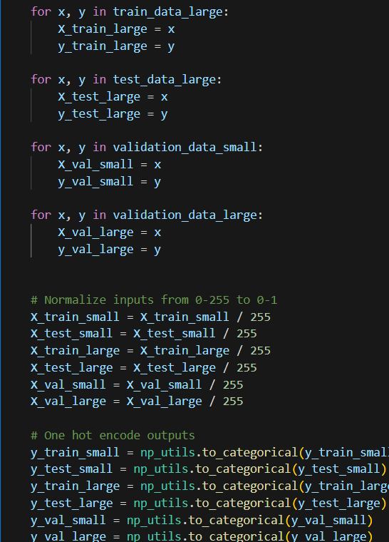
eda
Preprocessing of data
It can be seen that there are 15 types of different vegetables with their name labels on it.
The data is separated into x and y variables that are training, testing and validation sets and normalization is done to the input data to scale it to 0 and 1 while one hot encoding converts categorical labels into binary vectors, where each vector has a 1 in the position corresponding to the class and 0 everywhere else.

Slide 6
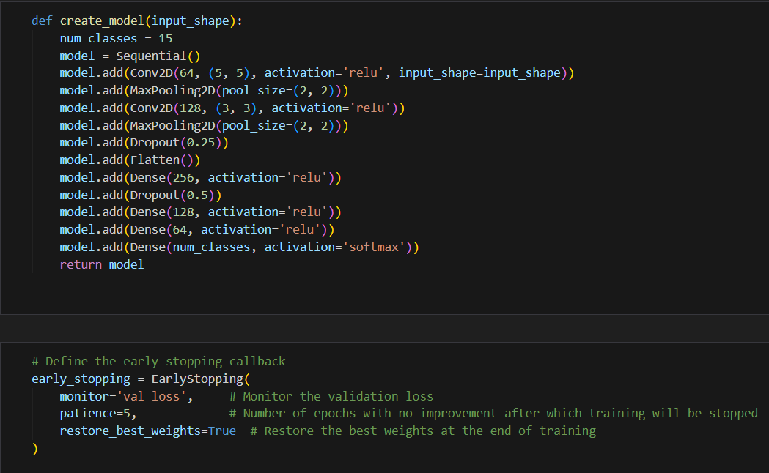
Model evaluation
This is my create model function that takes in pixel small and pixel large and I am also defining early stopping with patience of 5.

Slide 7
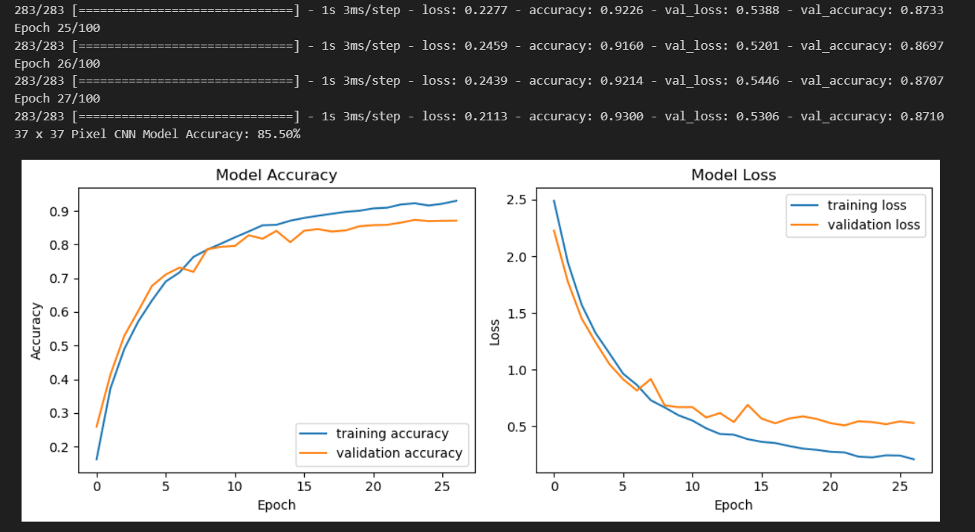
Model evaluation 37 x 37 model
Epochs: 27
37 x 37 CNN model accuracy = 85.50%
From the graph, we can see that the validation accuracy is lower than the training accuracy, and the validation loss is higher than the training loss, which shows that there may be some overfitting.

Slide 8
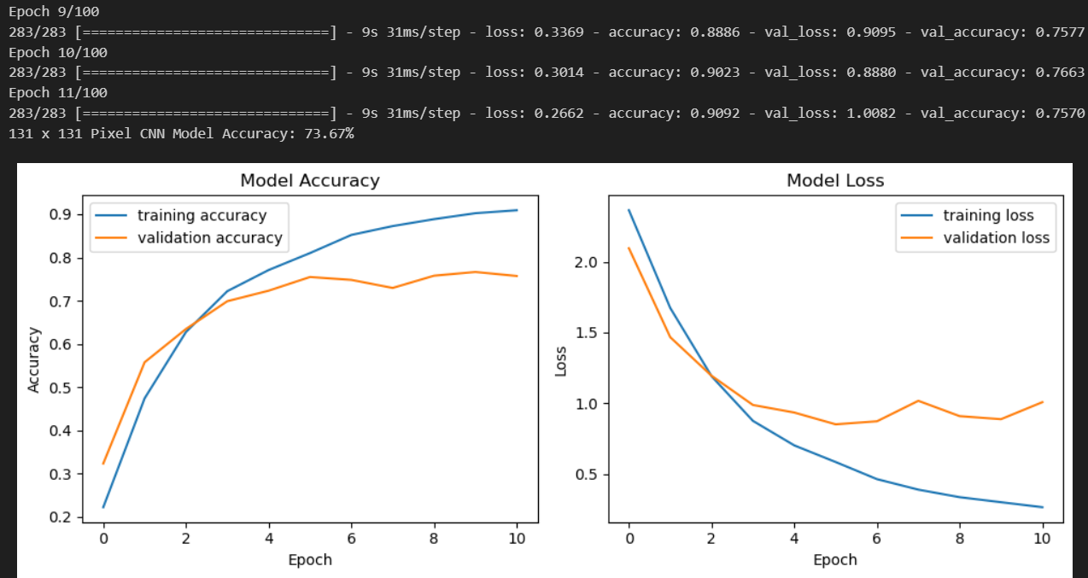
Model evaluation 131 x 131 model
Epochs: 11
131 x 131 CNN model accuracy = 73.67%
From the graph, we can see that the validation accuracy stays the same and the validation loss decreases at a slower rate after around epoch 4, which could indicate some degree of overfitting.

Slide 9
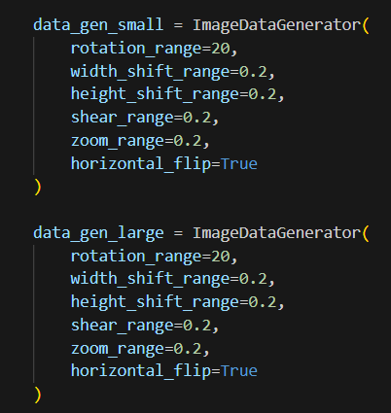
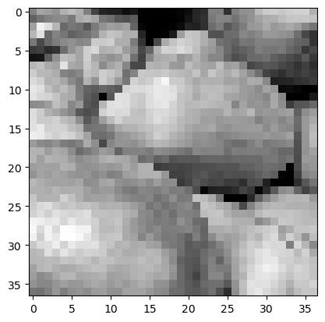
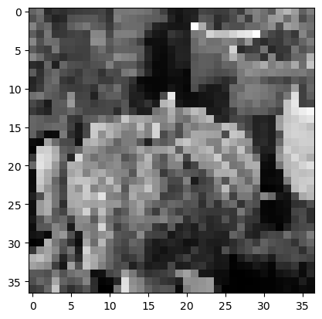
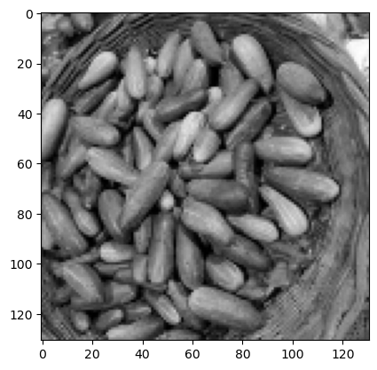
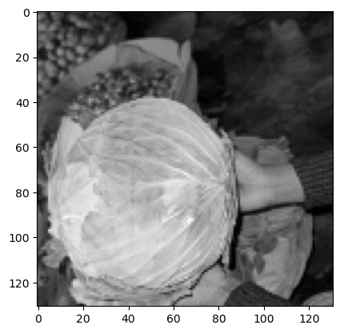
Model improvement with data augmentation
Resized and rescaled 37 x 37 images
Defined two data aug generator for small and large model
Resized and rescaled the 131 x 131 images

Slide 10
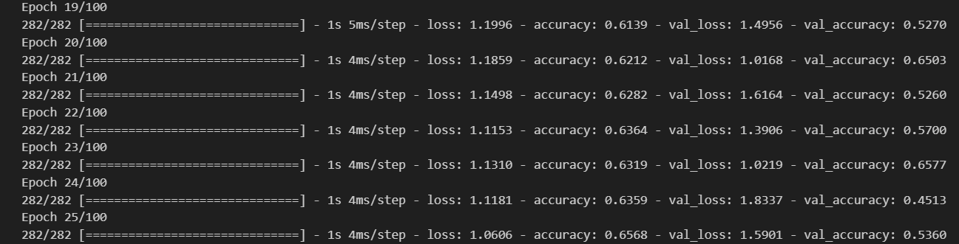
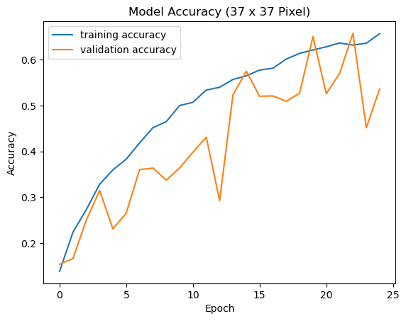
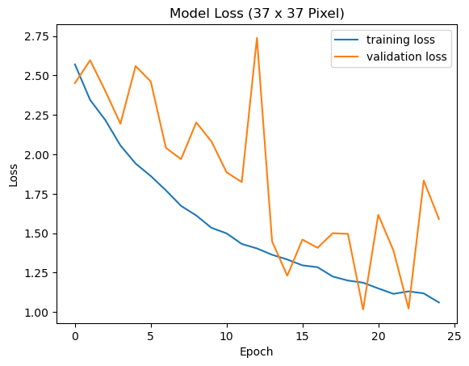
Model improvement with data augmentation
25 epochs
We can see from this that after data aug, the 37 x 37 model decreased significantly in accuracy which may imply that resizing and rescaling of 37 x 37 image is not feasible.
In summary, the training loss decreases as the number of epochs increases, which indicates that the model is learning and improving its performance. However, the fluctuations in the validation loss could suggest that the model might be overfitting to the training data.
The validation accuracy is not as high as the training accuracy, especially towards the later epochs. This could suggest that the model might be overfitting to the training data, as it’s not performing as well on the unseen validation data.

Slide 11
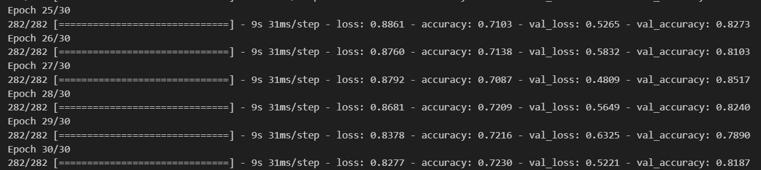
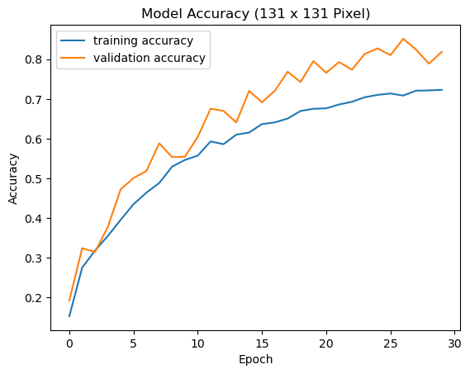
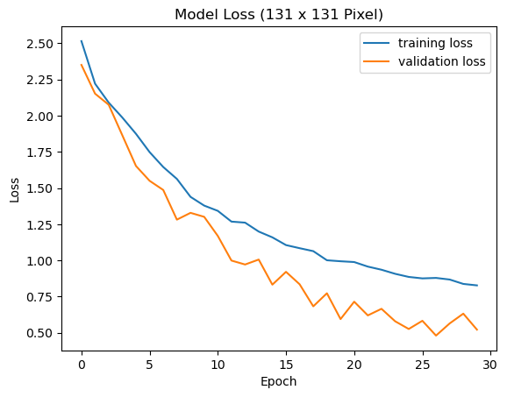
Model improvement with data augmentation
30 epochs
We can see from this that after data aug, the 131 x 131 model increased significantly in accuracy which may imply that resizing and rescaling of 131 x 131 image is better for larger pixel sized model.
This graph means that my model is fitting the training set better, but is losing its ability to predict on new data, indicating that your model is starting to fit on noise and is beginning to overfit.
This graph indicates that the model is learning and improving its performance. However, the fluctuations in the validation loss could suggest that the model might be overfitting to the training data, as it’s not performing as consistently on the unseen validation data.

Slide 12
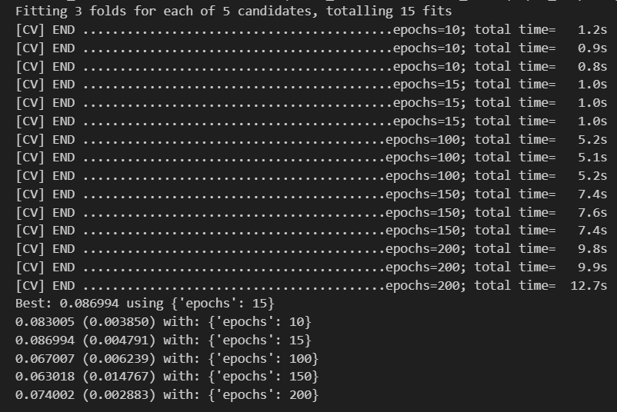
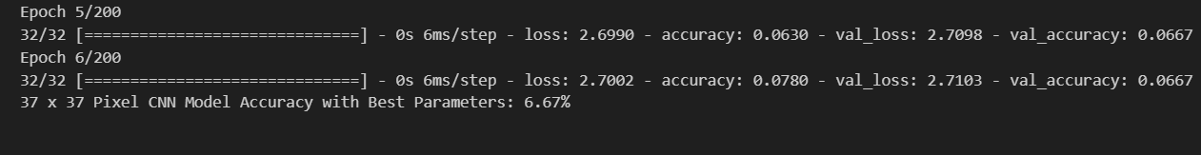
Model improvement with hypertuning 37 x 37 model
It seems that I have some error in my code with my hyper parameter tuning which resulted in my accuracy all becoming so low.

Slide 13
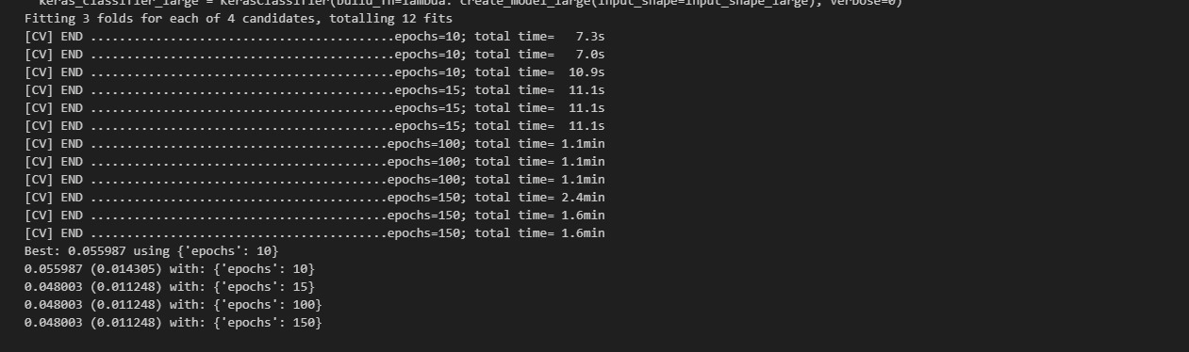
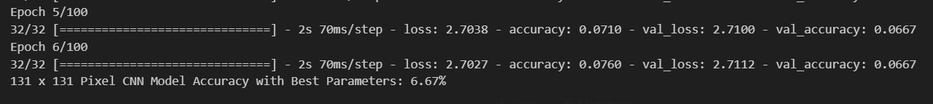
Hypertuning 131 x 131 model
The same goes for my hyperparameter tuning which has some error causing the accuracy to both be so low.

Slide 14
Final evaluation
From the model evaluation, the 37 x 37 model without data augmentation has the best accuracy of 85.50% while the 131 x 131 model with data augmentation has the best accuracy of 84.90%.

Slide 15
Ca1 dele rnn

Slide 16
Table of content
Background research and exploratory data analysis
Feature engineering
Modelling and evaluation
Model improvement

Slide 17
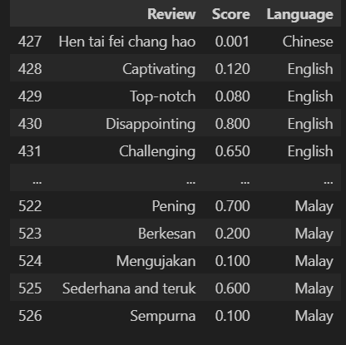
Background research
This dataset consists of 527 movie reviews from 4 different languages, English, Malay, Chinese and Malay. I am required to provide a analysis of the movie reviews.
There are three columns Reviews, Score and Language. The reviews are the thoughts and feelings that the user has for the movie that they watched and the score is what they feel the movie deserves out of 1 but some reviews and scores do not match and the language is what the review is written in which some feature engineering has to be done to translate all of them to English so I can have more data to work with.

Slide 18
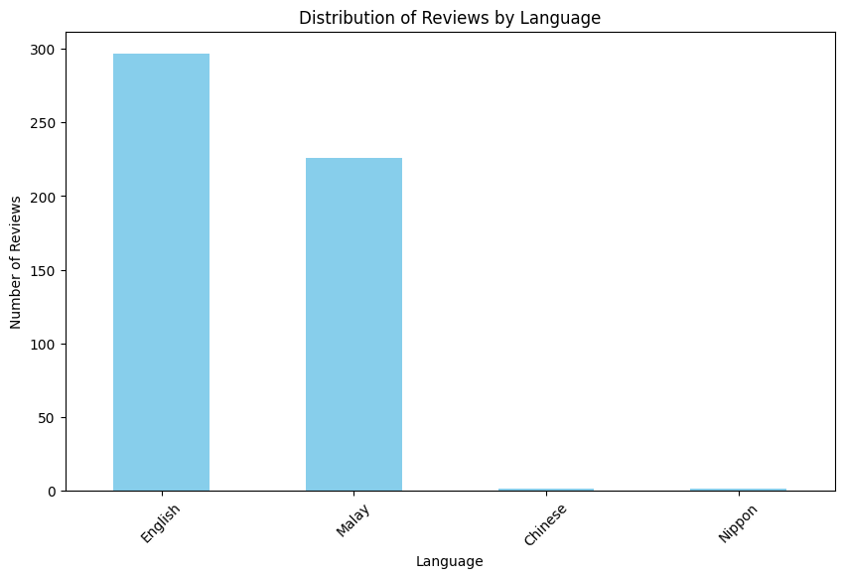
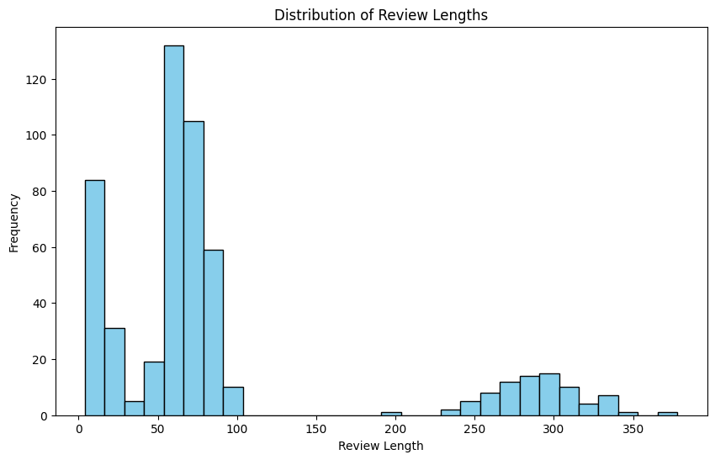
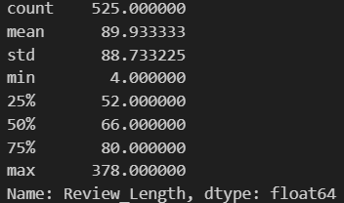
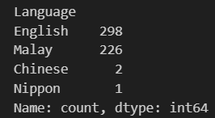
EDA
This graph shows the disparity between long reviews and short reviews are quite large so I will do feature engineering to split the long reviews into shorter ones.
This shows the amount of reviews that each language has.

Slide 19
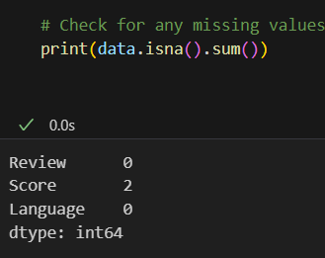
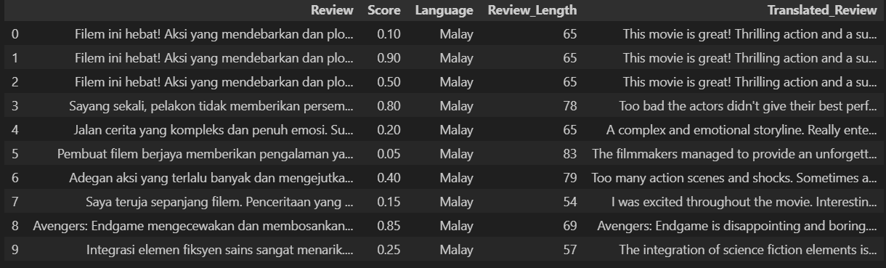
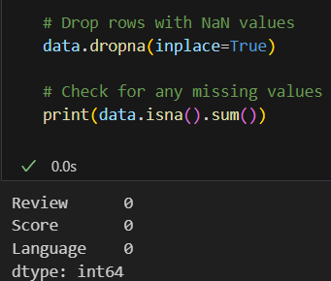
Feature engineering
I have translated the malay reviews to English reviews which allows me to have more data to train with now.
Checking for NaN values and have 2 so I am going to drop them as the NaN values are too small.

Slide 20
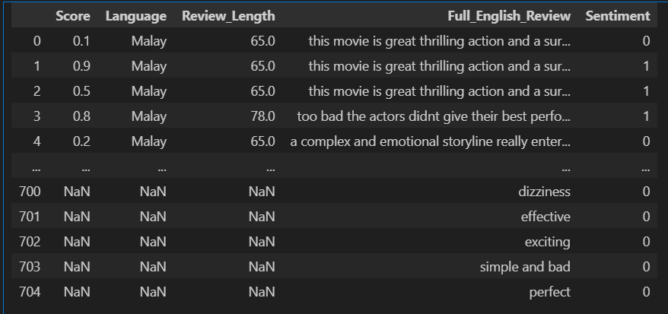
Feature engineering
I have created a function that splits the reviews based on every 15 words so now I have more data for my model.
I now have 705 rows for my model to train on

Slide 21
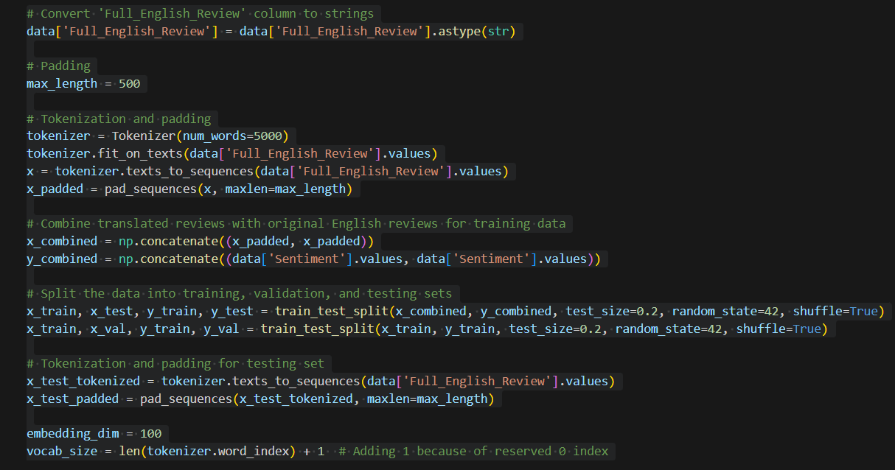
Preprocessing of data
This code helps me to preprocess my data to prepare for model evaluation. It first converts the full eng column to string which ensures that the reviews are in the correct format for the subsequent text processing steps. Then tokenization is done and The combined data is split into training and testing sets. 20% of the data is reserved for testing the model’s performance. The training data is further split into training and validation sets. The validation set, which is 20% of the training data, is used to tune the model’s parameters without touching the test set.

Slide 22
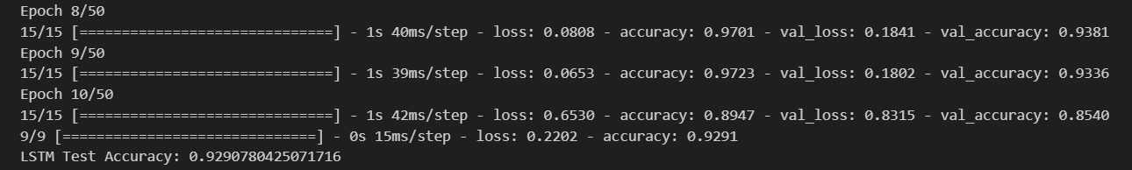
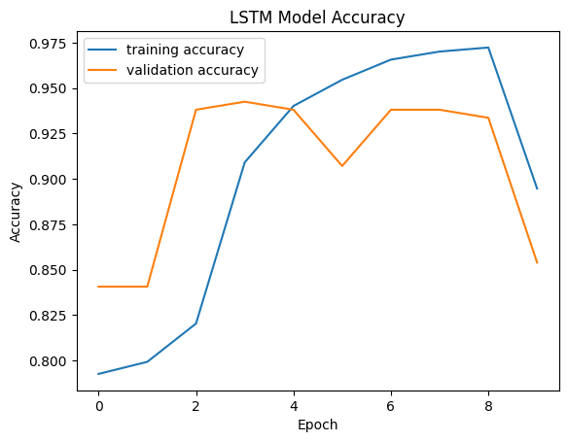
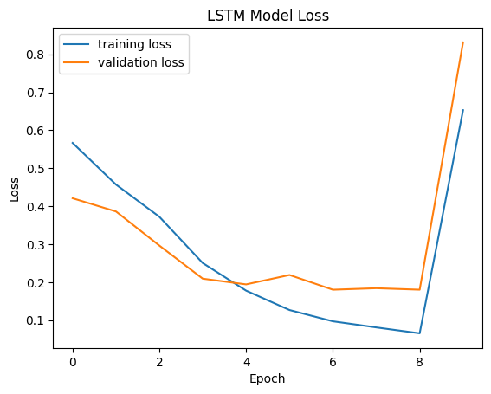
Model evaluation
Lstm accuracy = 92.91%
In the graph, the training accuracy is consistently higher than the validation accuracy. This suggests that the model is overfitting the training data.
as the number of epochs increases, both the training loss and validation loss decrease. This suggests that the model is learning from the training data and improving its performance. However, the validation loss is consistently lower than the training loss which could indicate underfitting.

Slide 23
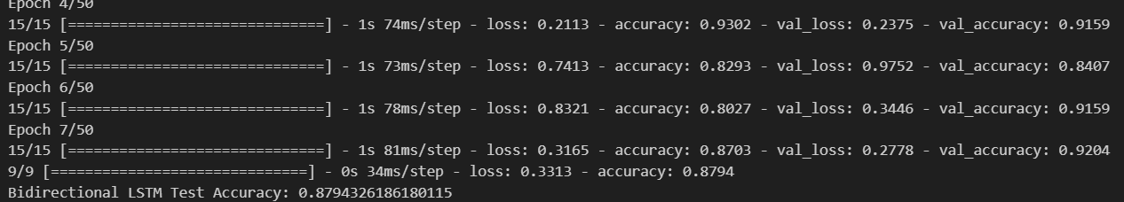
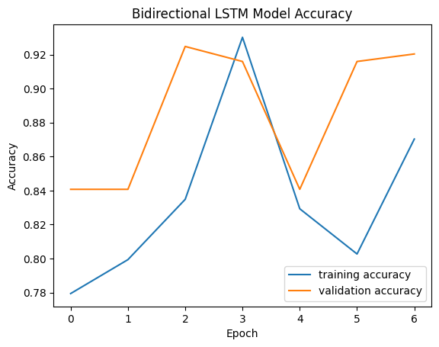
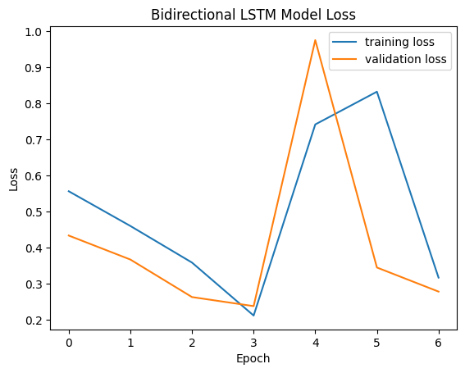
Model evaluation
Bidirectional lstm = 87.94%
The blue line shows a consistent increase in training accuracy across epochs. The orange line for validation accuracy fluctuates, peaking at epoch 2 and epoch 5. This pattern suggests that the model might be overfitting after the 2nd epoch.
in this graph the validation loss appears to hover around 0.8, which is higher than the training loss which goes down to around 0.3. The fact that the validation loss is higher than the training loss suggests the model might be overfitting.

Slide 24
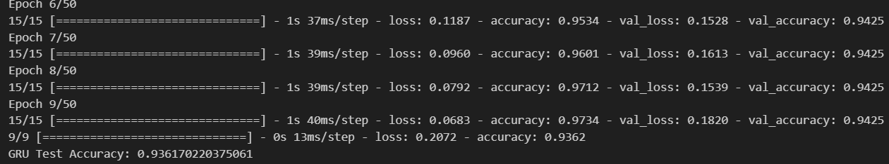
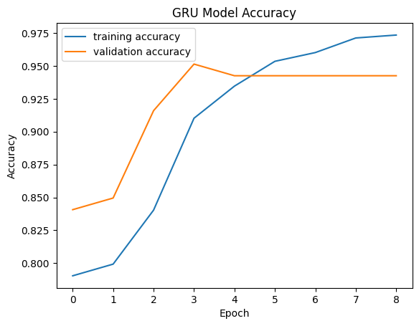
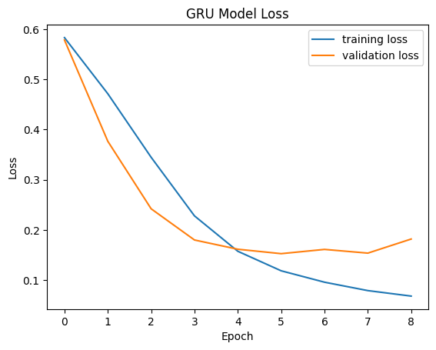
Model evaluation
GRU accuracy = 93.62%
The training accuracy indicates that the model's performance on the training data is improving as it is trained on more epochs. The validation accuracy suggests that the model's performance on the validation data is not significantly improving over time. This shows that the model is overfitting the training data.
The validation loss never reaches a value as low as the training loss. This suggests that the model is performing better on the training data than on unseen validation data. However there may be some form of overfitting because the training loss is lower than the val loss from 5epochs to 8.

Slide 25
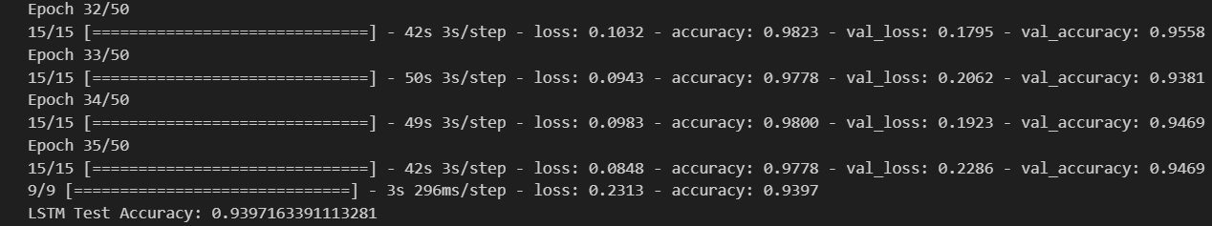
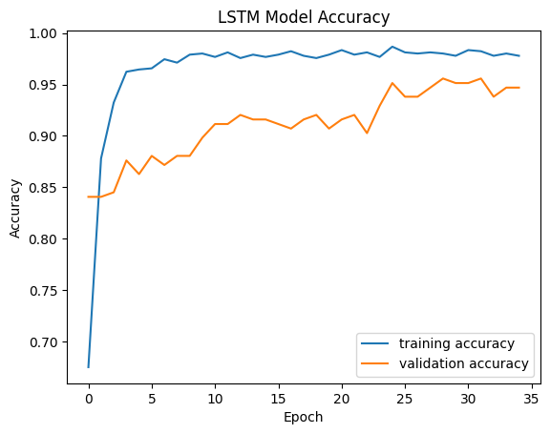
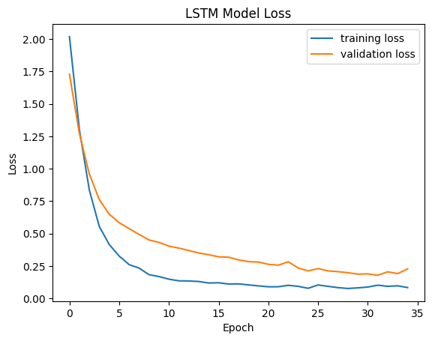
Model improvement (lstm)
I added dropout, batch normalization and regularization to all three of my models to see whether my accuracy will improve or not.
As the number of epochs increases, the training loss (blue line) generally decreases. This means that the model is learning to fit the training data better. The validation loss (green line) also decreases, but to a lesser extent than the training loss. This suggests that the model may be overfitting the training data.
Lstm accuracy after improvement = 93.97%
The graph shows that the training accuracy is higher than the validation accuracy suggests that the model may be overfitting the training data. This means that the model is learning the specific details of the training data rather than the underlying patterns. As a result, the model may not perform well on unseen data..

Slide 26
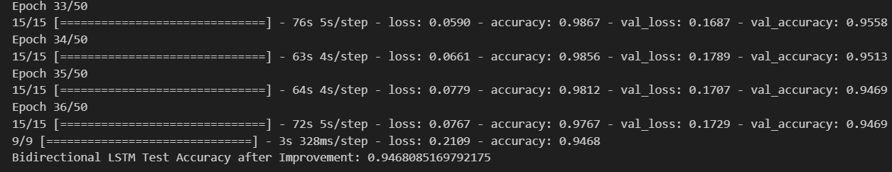
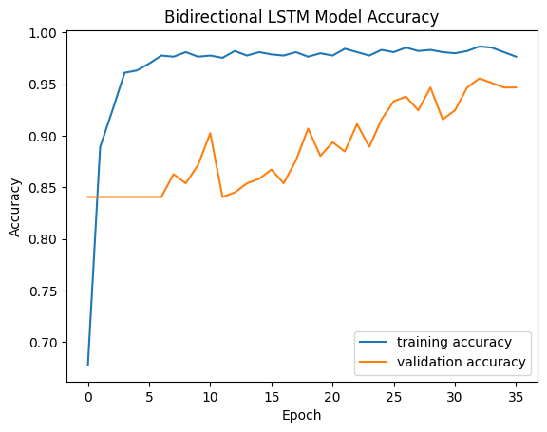
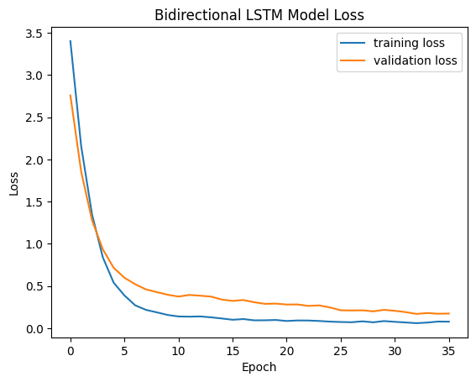
Model improvement ( bidirectional lstm)
Bidirectional lstm model accuracy after improvment = 94.69%
I added dropout, batch normalization and regularization to all three of my models to see whether my accuracy will improve or not.
In conclusion, the graph shows that the bidirectional LSTM model is learning the training data. However, the fact that the training loss is lower than the validation loss suggests that the model may be overfitting the data.
In general, a higher accuracy indicates that the model is better at making correct predictions. In this case, the fact that the training accuracy is higher than the validation accuracy suggests that the model may be overfitting the training data.

Slide 27



Model improvement
I added dropout, batch normalization and regularization to all three of my models to see whether my accuracy will improve or not.
GRU accuracy after improvement = 95.74%
In this case, the training accuracy is always higher than the validation accuracy which shows that itmay be overfitting the training data. This means that the model is learning the specific details of the training data rather than the underlying patterns. As a result, the model may not perform well on unseen data.
In conclusion, the graph shows that the GRU model is learning the training data. However, the difference between the training loss and validation loss suggests that the model may be overfitting the data.

Slide 28
Final evaluation
ALL three of the models improved in accuracy after model improvement with GRU having the highest accuracy of 95.74% followed by bidirectional LSTM of 94.69% and LSTM of 93.97% .

